Slide 1

第3章 Computability Theory I 丘奇-图灵论题
本章内容及要求：
Introduce the Turing Machine (TM)?
  Proposed by Alan Turing in 1936
  finite-state control + infinitely long tape
  A stronger computing device than the DFA or PDA
  图灵机形式化定义: 格局,图灵可识别的语言,图灵机例子
图灵机变形Variants
  With Multiple Tapes
  With Non-deterministic Choice
  With a Printer
Introduce Church-Turing Thesis
  算法(definition of algorithm)和图灵机术语

Slide 2
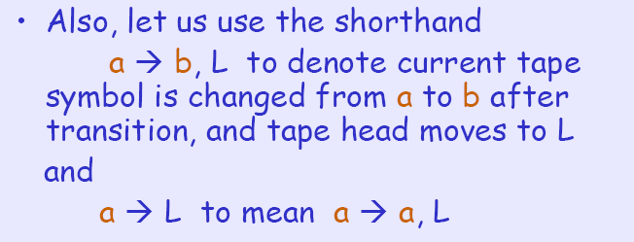
Example of TM
Let us try to describe formally a TM that
recognizes { w#w | w in {0,1}* }

Slide 3
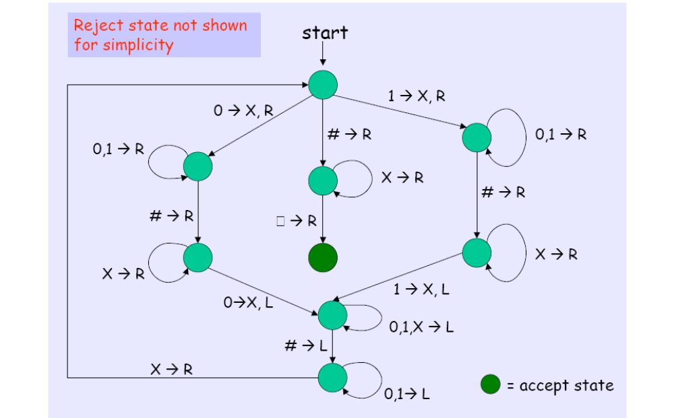
Example of TM

Slide 4

Example of TM
Full details of TM are sometimes complicated
Usually, we give high-level details instead (but they must be precise enough for understanding)
Let us try to describe the high-level details of a TM M2 that recognizes the

Slide 5
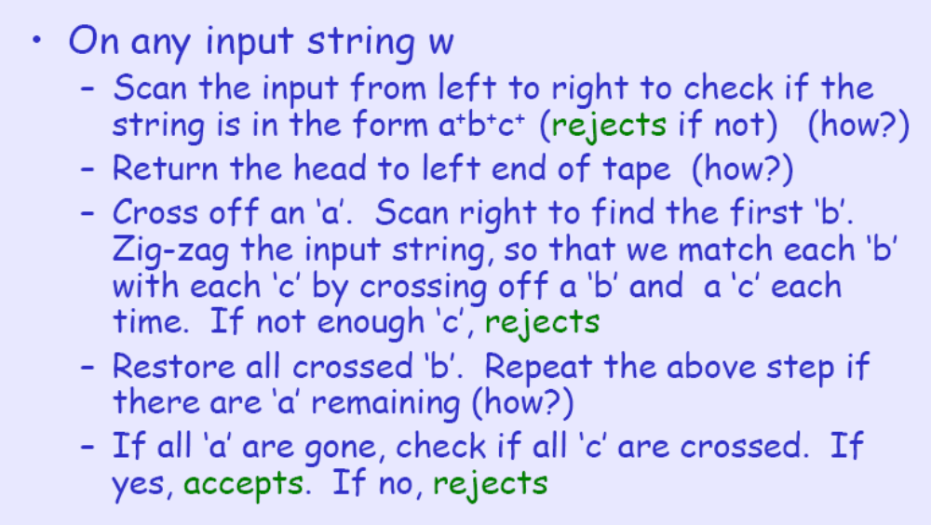
High-Level Details of M2

Slide 6
TM design
Let Σ= {a, b} and Γ = {a, b,#,B}. Give a state diagram for a TM that when started in q0w for w∈ {a, b}* halts in the configuration #q_{accept}w. That is, the machine shifts w to the right by one position and puts a # in the first position on the tape.

Slide 7
TM design
Solution: the machine moves to the right till it sees a blank at the end of the input and then shifts the string to the right one symbol at a time to create space for the # to be inserted in the first position. Note that it uses the feature that when the TM moves left from the first position
on the tape it remains in the first position.

Slide 8
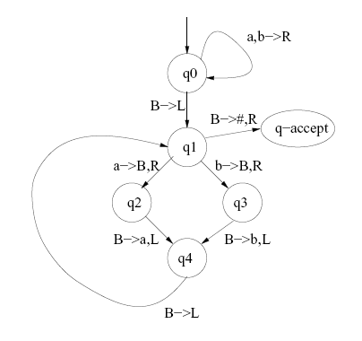
TM design
Solution: the machine moves to the right till it sees a blank at the end of the input and then shifts the string to the right one symbol at a time to create space for the # to be inserted in the first position. Note that it uses the feature that when the TM moves left from the first position
on the tape it remains in the first position.

Slide 9
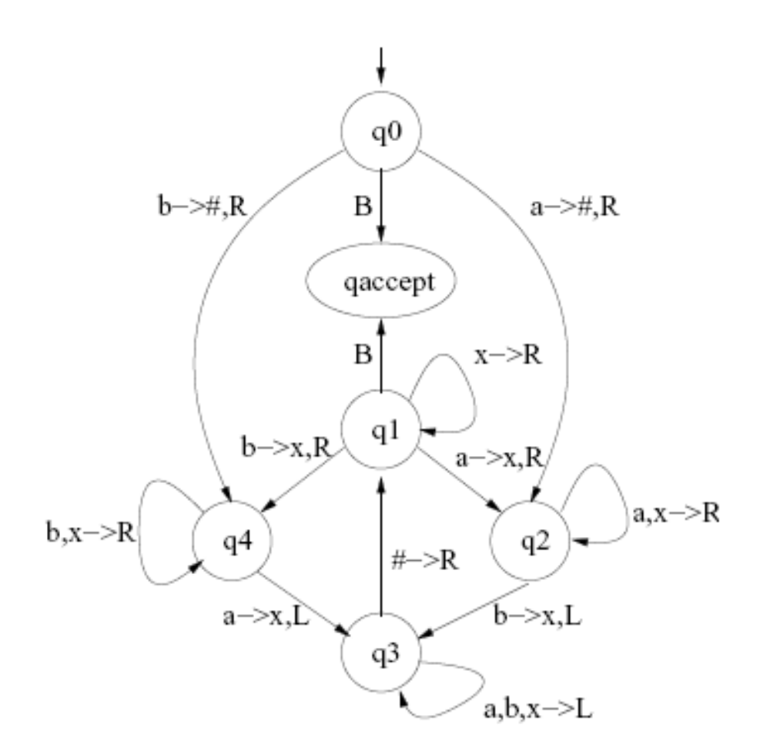
TM Understanding
Consider a TM given by the following state diagram. The input alphabet is {a, b}. The state
q_{reject} is not shown explicitly.

Slide 10
TM design
What is the language accepted by the machine? Briefly justify your answer.
Solution: The machine decides the language
L = {w ∈ {a, b}* | w has equal number of a’s and b’s}.

Slide 11
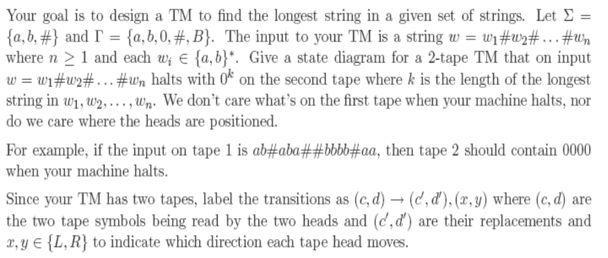
TM Design

Slide 12
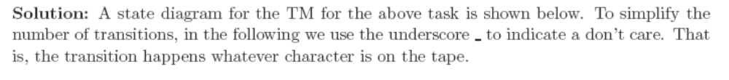
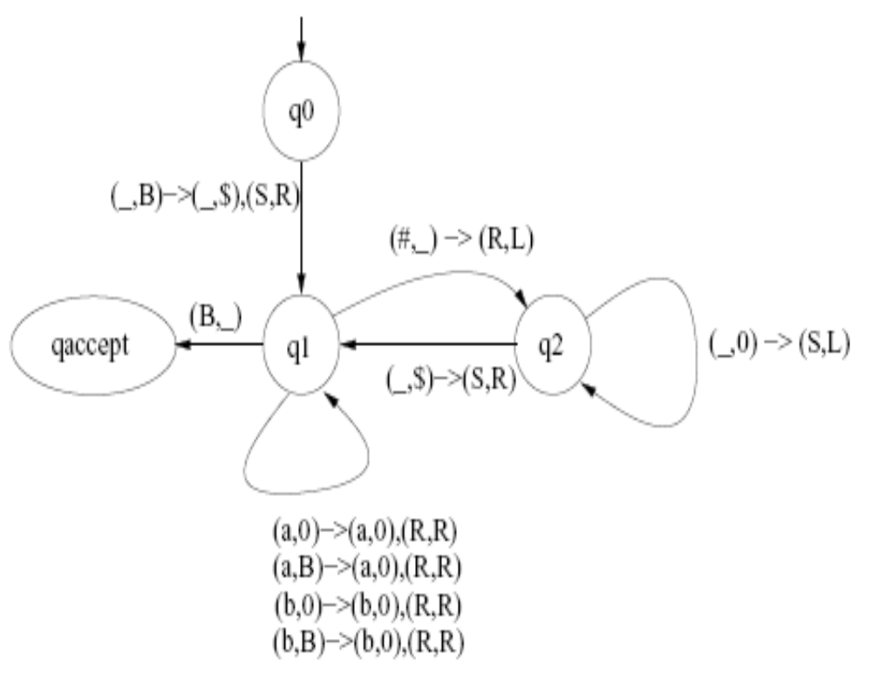
TM Design

Slide 13
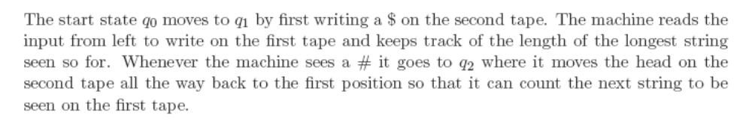
TM Design

